Slide 1
EBIP - Innovative Technologies for a Sustainable Water Management
What is EBIP?
The Executive Blended Intensive Programme (EBIP) is designed to train a new generation of skilled young researchers and academic professionals engaged in sustainable water management.
The programme offers an interdisciplinary and international training experience, with both online and in-person sessions, to address critical challenges in water resources and sustainability, especially in the context of the African continent.
Our Objectives
🔹 Strengthen participants’ understanding of global sustainability challenges for Africa.
🔹 Provide cutting-edge tools and methodologies for high-quality research and training.
🔹 Promote long-term cooperation between African and Italian universities through academic mobility and joint research.
Key Dates
📢 Call Opens: 27 June 2025
⏰ Application Deadline: 17 July 2025
✅ Participant Selection: 10 August 2025
🎓 Course Period: October – December 2025
Funding & Costs
🎓 Scholarship: €3,000.00 (to support travel, accommodation, and living expenses)
📝 ENIT Registration Fee: €300.00 (covers administrative and infrastructure costs)

Slide 2
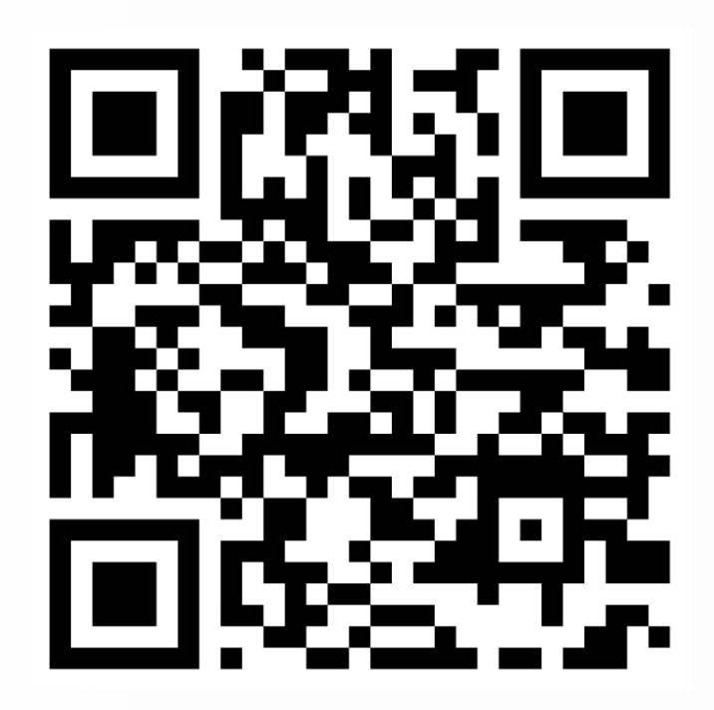
Who Should Apply?
✔️ Young researchers, PhD students, early-career faculty
✔️ Applicants with academic or professional backgrounds in:
Water and environmental engineering
Natural resource management
Climate change adaptation
Sustainability science
Programme Format
This blended learning experience includes:
Online and On-site modules focused on theory and methodologies
On-site sessions in Tunis, including labs, workshops, and field visits
Mentorship by African and Italian experts
Ready to join?
Apply by 17 July 2025 and become part of a dynamic network committed to building water resilience for the future.
For more information, visit LINK

